Slide 1
TWITTER SENTIMENT ANALYSIS

Slide 2
Contents
AIM
SENTIMENT ANALYSIS
TWITTER API
FLOWCHART
PRE PROCESSING STEPS
APPLICATIONS
CONCLUSION

Slide 3
aim
The main goal is to connect on Twitter and search for the tweets that contains a particular keyword and then evaluate the polarity of the tweets as positive , negative or neutral

Slide 4
Why sentiment analysis
a) Sentiment analysis is a analysis technique that categorizes text data based on its aspects and identifies its sentiment. It is used to analyze customer feedback data by correlating sentiments to various aspects of a product or service.
b) Among many analytical fields, one in which humans outperform all others is the ability to recognize feelings. However, for feedback presented to you, such as 40–50 or even 100, this is doable. However, if you have a data set of, say, 10,000 reviews, manually analyzing them becomes impossible.
C) Our invention solves the analysing thousands of revies fast and efficient using machine learning algorithms

Slide 5
Why Twitter Api
Twitter is a platform created openly for public opinion. The consuming public is not an exception; we are sure to find them on the platform covering current issues. We find opinion leaders, key influencers, and relevant brands on Twitter. By using a Twitter sentiment analysis, companies will have a much clearer perspective on the sentiments of users concerning products and services, market trends, and the successes and failures of the competition. Twitter is an excellent metric of general consumer sentiment. It will be helpful to study a niche and its market trends

Slide 6
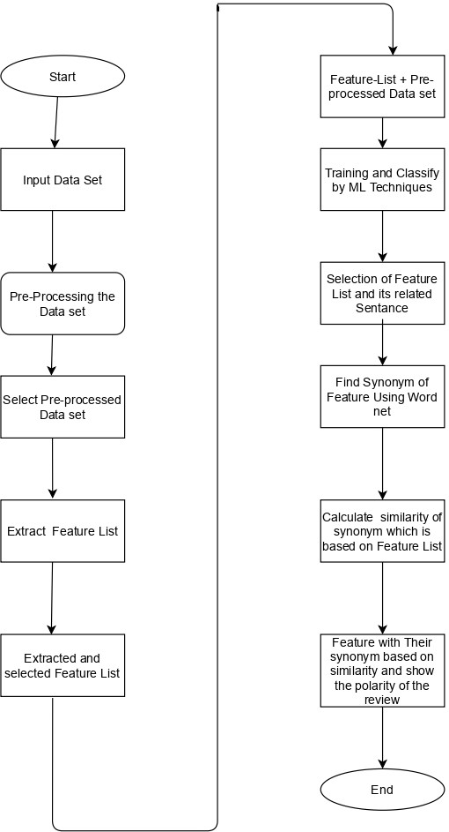

Slide 7
Pre processing steps
The sentiment score of a text is determined by:
Giving each token a separate score based on the emotional tone,
Calculating the overall polarity of the sentence,
Aggregating overall polarity scores of all sentences in the text.

Slide 8
applications
Sentiment analysis can identify how your clients feel about the highlights and benefits of your products or services. This may help and reveal areas of opportunity that may not have been mindful of before.
Sentiment analysis can offer assistance for companies to distinguish new trends, analyze competitors, and test emerging markets

Slide 9
conclusion
People are using forums, social networks, blogs, and other platforms to share their opinion, thereby generating a huge amount of data. Companies and organizations are interested in automatically analyzing this user-generated data in order to efficiently learn about it at scale. Sentiment Analysis is related to generating a dictionary by tagging words, the latter involves the consideration of syntactic patterns

Slide 10
THANK YOU

